Slide 1
Subsystem Breakdown Description and Examples
Data Communication/Storage - Manny
-Sending data from ESP32 to database
-Choose method to send data ex. MQTT, HTTP
-Choose database to hold data ex. Local excel, influxDB, google sheets
Machine learning
Model & training data - Andrew
-ML model type used to disaggregate data ex. linear regression, decision trees
-Verifying model accuracy against existing models
-Finding source of reliable training data to compare against
Data Processing and Pipelining - Labib
- Getting external data sources (REDD, UKDale) into usable forms
-Preprocessing data before it goes to ML model ex. remove errors, add weather data from online
-Sending processed data to ML model from database
-Sending ML data from model back to database or website
Website/User interface - Ralph
-Displaying data on new website or existing dashboard ex. Grafana, sheets
-Allowing user inputs/view customization ex. input power cost, date range
-Could include how a users data is linked to them ex. over wifi, account login, user ID
-Option of mobile view

Slide 2
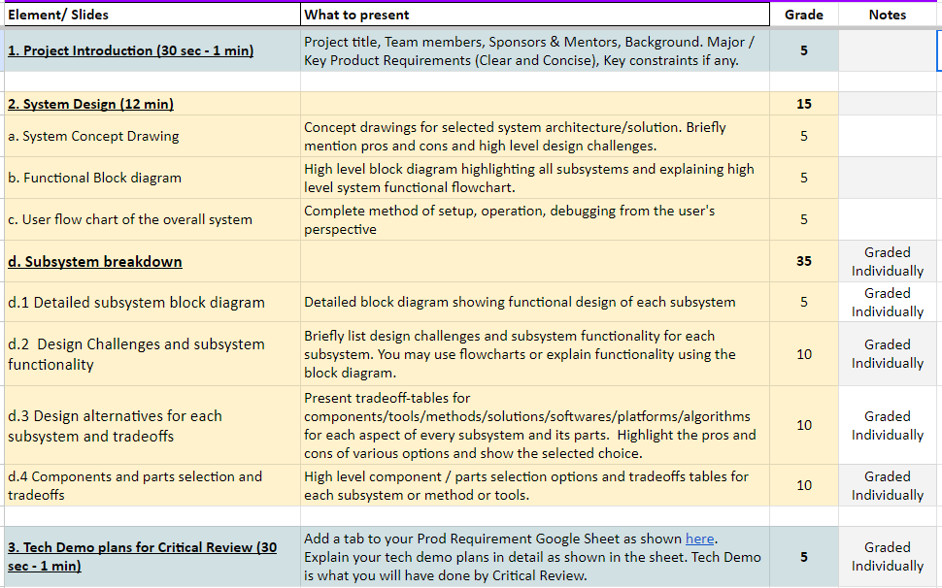
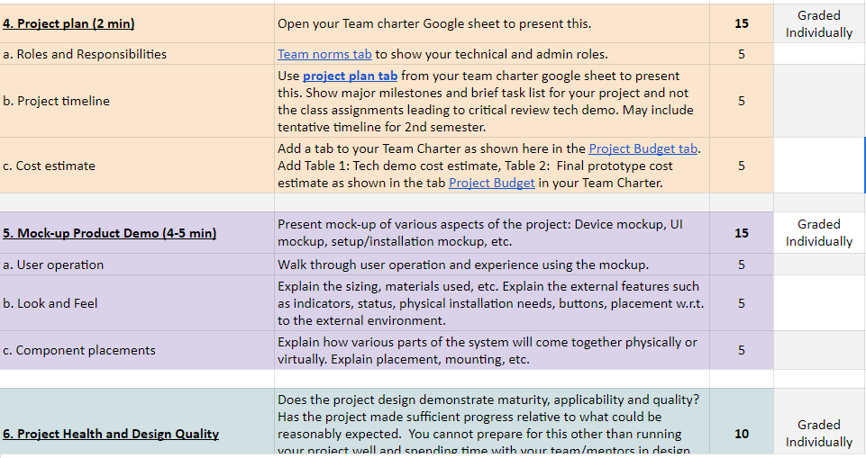
Requirements - remove before presentation

Slide 3
Preliminary Design Review
Residential Power Disagreggation Team 50
Team Members
Andrew Bailey, Ralph Cullom, Manny Harris, Labib Kasim
Mentor - Sponsor
Huangjie Gong - ABB

Slide 4
Project Introduction
Our project is creating a cost-effective, IoT-driven system to be employed by consumers which will disaggregate various residential loads. This device will incorporate machine learning and advanced data processing techniques to break down and forecast residential load across different categories based on the aggregated measurement, then display them for the user.
Key features:
Device measures lumped power usage of a household.
Data that the device collects should be sent wirelessly back to online data storage through IoT.
Machine learning algorithms will take the data and weather as inputs and output the disaggregated loads and predicted use.
Measured and predicted data will be displayed to the user.
Key constraints:
Final cost of the product should be no more than $100.
Device shall be small enough to fit neatly inside the residential panel.

Slide 5
System Design

Slide 6
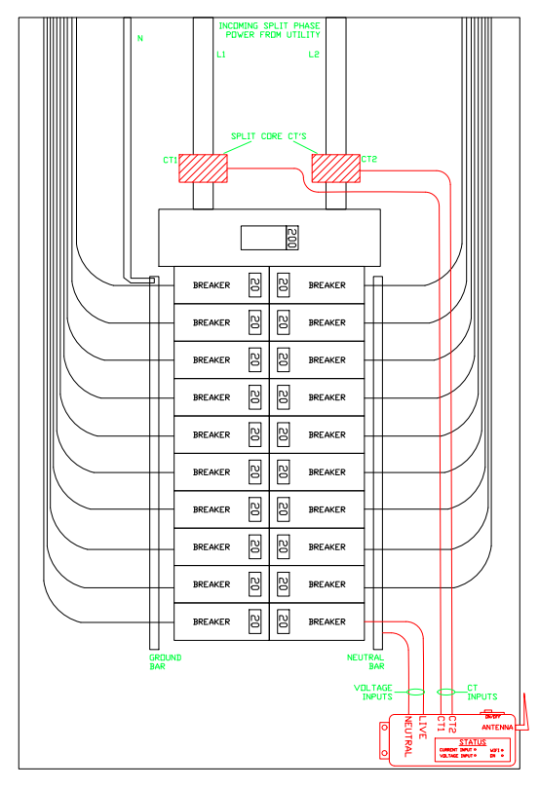
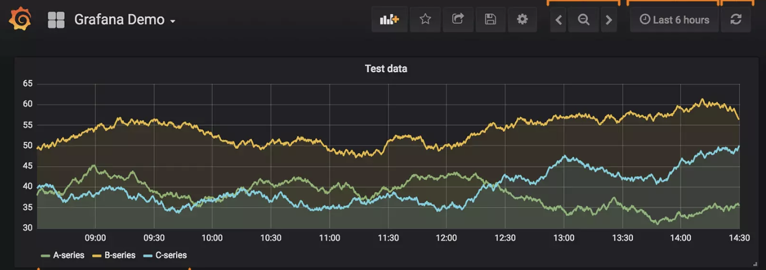
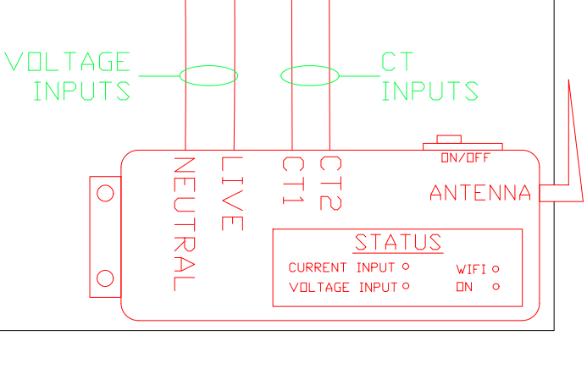
Concept Drawing

Slide 7
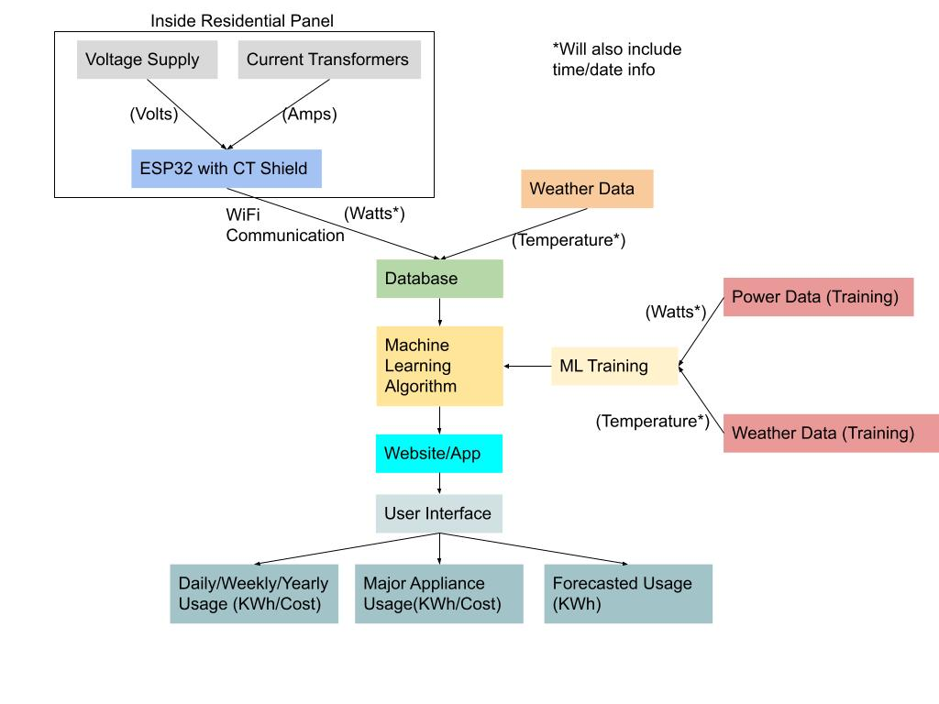
Functional Block Diagram

Slide 8
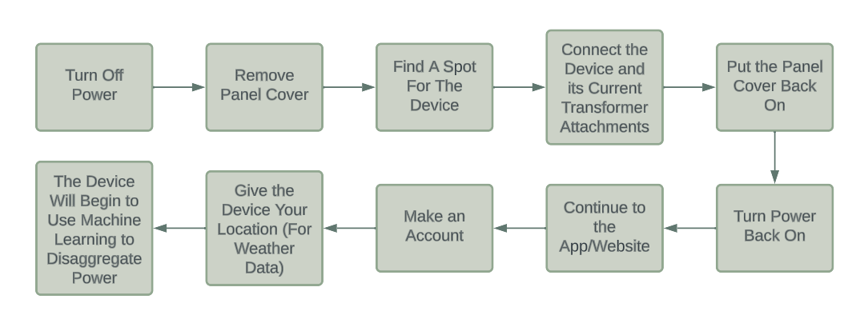
User Flow Chart

Slide 9
Subsystem Breakdown

Slide 10
Device Communication
Manny

Slide 11
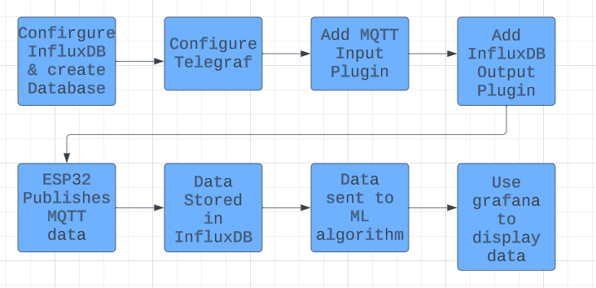
Subsystem Block Diagram and Subsystem Functionality
InfluxDB & Telegraf Implementation

Slide 12
Subsystem Functionality
3)[[inputs.mqtt_consumer]]
servers = ["tcp://broker_address:1883"]
topics = [ "topic_name" ]
//Adds the MQTT input plugin ans pecifies broker and topic to subscribe to
4)[[outputs.influxdb]]
urls = ["http://localhost:8086"]
database = "mqtt_data"
//Specifies the connection details for InfluxDB. Also adds InfluxDB output plugin
5)sudo service telegraf restart
//Reset Telegraph so that the changes take place
Code Breakdown:
1)sudo service influxdb start //Starts InfluxDB service
CREATE DATABASE mqtt_data //Creates new database
2)sudo nano /etc/telegraf/telegraf.conf
//Opens Telgraf configuration file

Slide 13
Design Challenges
Data Integrity and Consistency
Ensure that data is accurately capturing without loss/corruption
Real-Time Processing
Avoid delays in recording and storing MQTT messages
Setting up InfluxDB and Telegraf on Raspberry Pi
Linking existing MQTT broker with InfluxDB and Telegraf
Send information to ML algorithm

Slide 14
Design Alternatives and Tradeoffs
Google Sheets
Requires gspread and paho-mqtt
Need API to interact with sheets document
Need a script to bridge the gap between MQTT and google sheets
ESP32 and Raspberry Pi must be connected to same MQTT broker
Have to run python strict on Raspberry Pi
Requires heavy python coding to write MQTT onto google sheets document
Easier to view and display data in form of graph
InfluxDB with Telegraf
A LOT less heavy coding and integration work
InfluxDB is designed to work with Telegraf and Gafana
Capitalizes on heavy use of MQTT data
Our primary goal is data analysis and visualization so a dedicated database provides a more robust and scalable solution
Looking Into Using InfluxDB Cloud
Would be the best option if we can get it up and running

Slide 15
Components and Parts Tradeoffs
 | Pro | Con
Raspberry Pi with InfluxDB & Telegram | Raspberry Pi is already measuring and storing MQTT data InfluxDB pairs well with grafana to display information | Requires a decent amount of coding Have to deal with integration
InfluxDB Cloud | Doesn’t require the use of a Raspberry pi InfluxDB pairs well with grafana to display information Get up to 30 days of free storage | Will have to update ESP32 and remove the Raspberry Pi from device Requires a lot of initialization steps to get system up and running

Slide 16
Machine Learning
Andrew & Labib

Slide 17
Machine Learning
Model & Training
Andrew

Slide 18
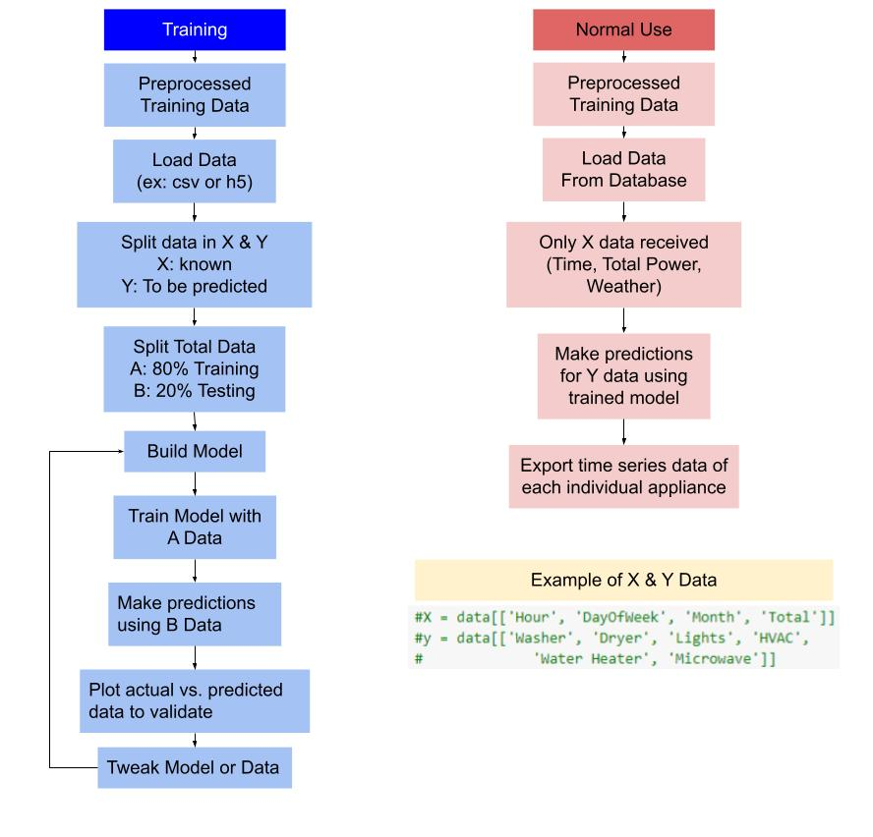
Subsystem Block Diagram
Notes:
Design challenges:
Reliable training data - We only have one reliable source for training data at the moment. Even with more sources for training data the model would not be generalizable without learning the power signatures each individual appliance uses. Using data containing only the signal of an appliances power usage could improve scalability.
Appliance efficiency or model - Different models of the same appliance will have differing power consumption and may be difficult to model based off signal profile or usage
Real time processing - Disaggregating data in real time could be very intensive for both the model and the hardware it runs on. Choosing a good interval for when to update data will reduce this load.
Validating the model - Even with the above mentioned method of validation, data that has never had part of it used for training will have to be used for model validation

Slide 19
Trade-offs
Gathering training data
Scaling the model
Generalization
Data Variability
Model type
Multiple Linear Regression
Hidden Markov Models (HMM)
Neural Networks
Combining these (ensemble)

Slide 20
Training Data Sources
Exterior source
Ex:REDD, Smart, UK Dale
Gathering Our Own Data
Pros | Cons
Large and diverse | Difficult to access
Community | Variable data types
Validation | Age of data
Free | Collection control
Pros | Cons
Control | Material Cost
Privacy | Time Cost
Continuity | Finding Users
Flexibility | Limited Data
Notes:
Exterior
Large and diverse - data sets go back very far
Community - Public data sets have research done by others
Validation - Compare our model outputs to others
Weird ways of storing the data
Data may be outdated and not good for training modern system
May be missing some features we want
Our own
Control - choose what to measure and how often
Privacy - we can deal with privacy concerns directly with the user
Continuity - keep data up to date, send directly to database
Flexibility - we can improve the collection method
Material cost - expensive set up
Time cost - building setup, finding user, and install
Finding users - hard to find users
Limited data - wait a whole year if we want a years data

Slide 21
Model Type
Model | Pros | Cons
Hidden Markov Models (HMM) | -Popular for NILM use (nilmtk) -Models time series data well | -Very sensitive -Preprocessing intensive
Neural Networks | -Can find complex patterns -Can adapt to unknowns | -Large amount of data needed -Computer intensive
Multiple Linear Regression | -Simple implementation -Fast and computer efficient | -Simple relationships -Outlier dependent
Combining (Ensemble) | -Predict appliances in one model better than the other -Model optimization | -Could be very difficult to implement -Dependencies on other models

Slide 22
Selection
Model
Hidden Markov Models (HMM)
Option to combine models (Ensemble)
Training
Gathered data for complete model training
Exterior sources for model development

Slide 23
Machine Learning
Data handling and preprocessing
Labib

Slide 24
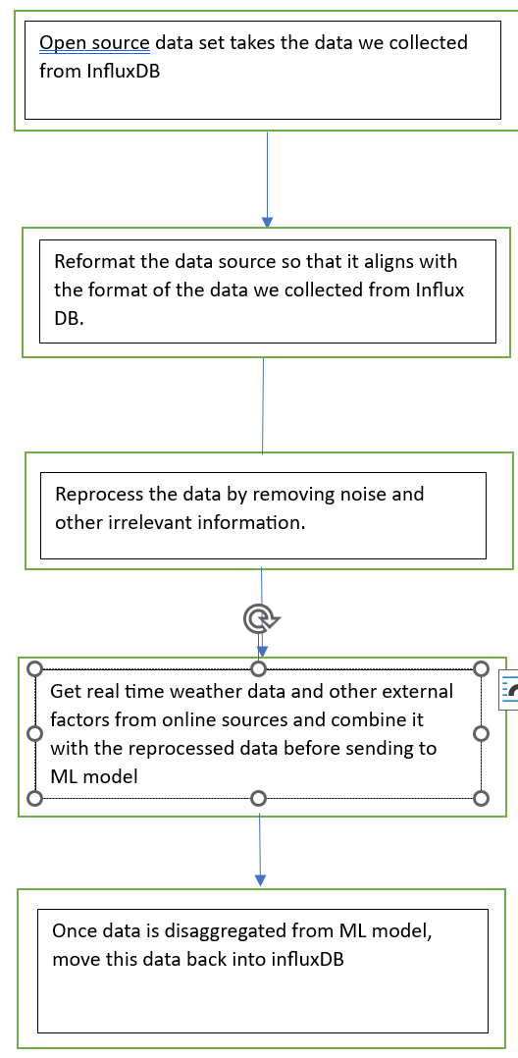
Subsystem Block Diagram

Slide 25
Design Challenges and Subsystem Functionality
REDD¹ - freely available data set which can be used for disaggregating our training data.
Contains detail power usage information.
Uses the FHMM technique.
A ‘REDDBox’ which Includes both hardware and software.
Hardware
Plug level data - measured using a wireless plug monitoring system developed by Emmetric²
Circuit level data - the eMonitor developed by Powerhouse dynamics³ with CTs that attach to each individual circuit
Can monitor up to 24 circuits and could read the power consumption at a rate of once per 3 seconds.
Whole home data - current measured using CTs from a TED⁴, voltage measured using an oscilloscope, and an ADC converter to convert analog signals to Digital readings.
Software
Laptop connected to each REDD box to extracts the data from the hardware, stores the data locally, and processes the data to the machine learning model.
Notes:
REDD - Reference Energy Disaggregation Data set
http://www.enmetric.com
http://www.powerhousedynamics.com/
http://www.theenergydetective.com/

Slide 26
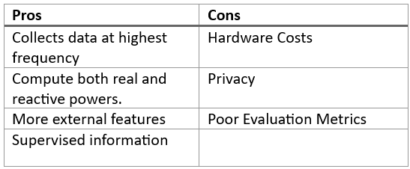
Pros and Cons and Parts Tradeoffs
Trade Offs
Higher frequency measurements coupled with lower frequency data
Supervised data with proper labels
More flexibility at the cost of limited privacy

Slide 27
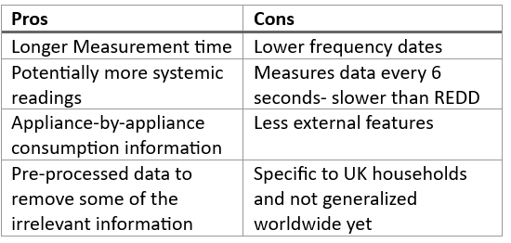
Alternatives and Tradeoffs
Alternatives to REDD for energy disaggregation - UK-DALE
UK-dale - open access data set for measuring domestic-level appliance energy

Slide 28
Website/UI
Ralph

Slide 29
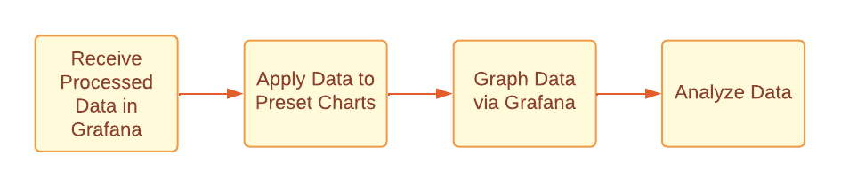
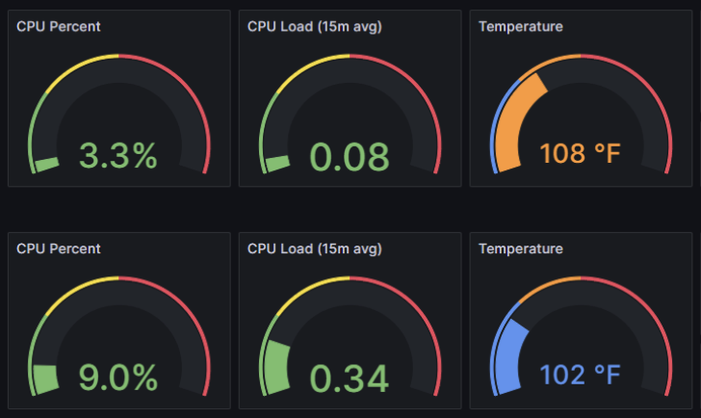
Subsystem Block Diagram

Slide 30
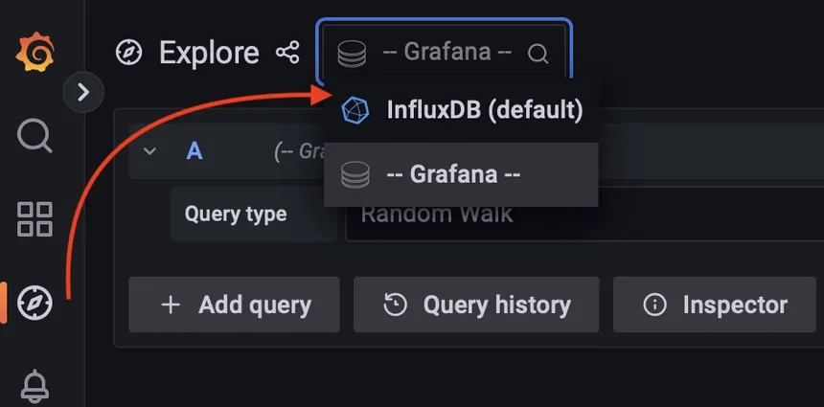
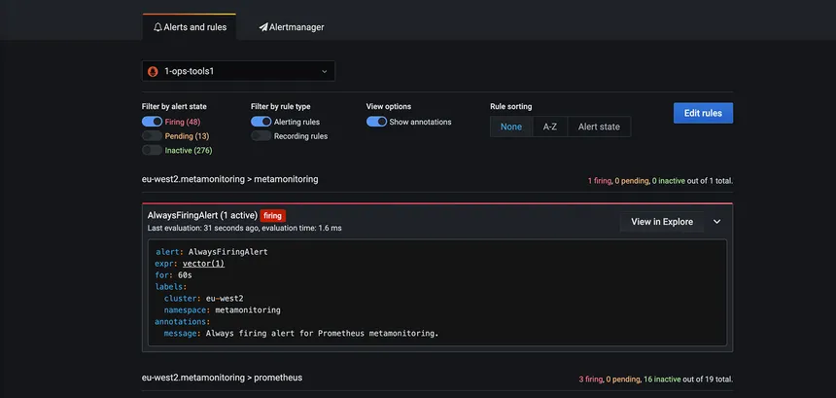
Design Challenges and Functionality
Setting up communication channels with the database
Ensuring data sends in real time, or as fast as possible
Manipulating the graphs to add or remove the data sources as needed automatically

Slide 31
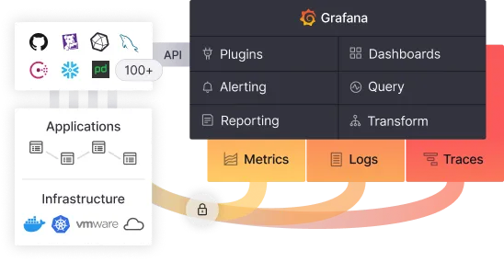
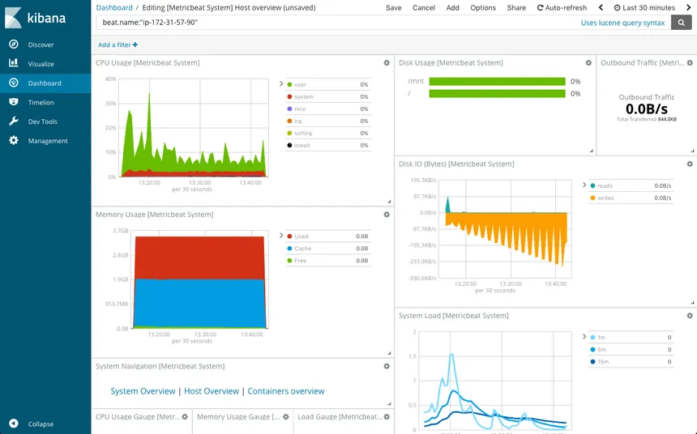
Graph Design Alternatives and Tradeoffs
Grafana (Pro/Cons)
Much more refined data analysis with many options
Data collection must be stored separately
Compatible with many data storage sites
Kibana (Pro/Cons)
Must pull data from particular sources
Required to work with products from the ELK stack to function
Fewer dashboards available

Slide 32
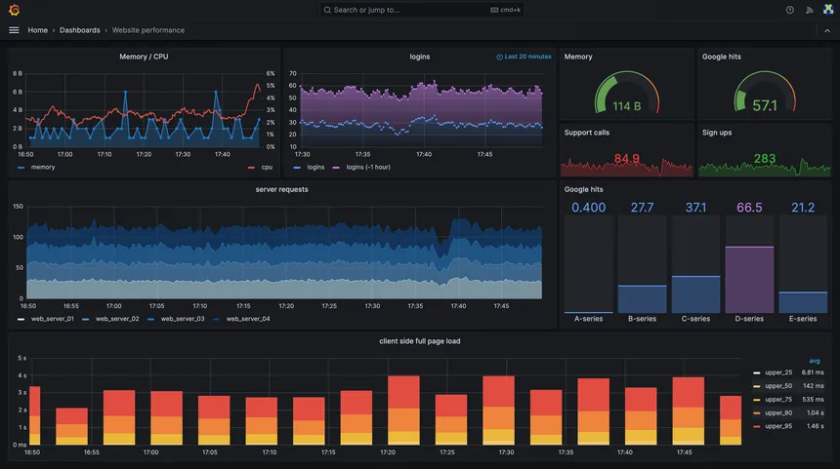
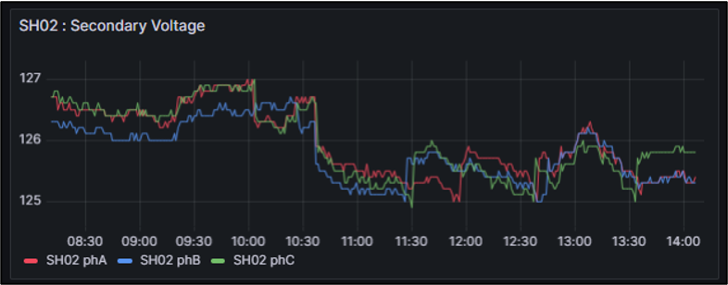
Component Selection and Tradeoffs
Total power usage in the residence
Power usage per device
Predicted power consumption
Past power consumption
Can Grafana do all of this?

Slide 33
Tech Demo Plans

Slide 34
Tech Demo Plans for Critical Review
Visual demonstration of our device
Show that our device can record, measure, and display data in real time
Show measurements being sent to database
Using previously recorded data
Show data being sent in and out of machine learning model
Show disaggregated data in database
Graphing predicted disaggregate vs. actual measurements

Slide 35
Project Plan

Slide 36
Team Charter - 50_ResidentialPowerDisaggregationFall_2023
Roles
Timelines
Cost

Slide 37
Mock-up Product Demo

Slide 38
Demo
Device
Transmitting to InfluxDB
Preprocessing data in InfluxDB
Sending preprocessed data to ML model
Sending disaggregated data back to InfluxDB
Displaying predicted data on Grafana

Slide 39
Questions
and
Discussion
Notes:
Slide template from slides.com

